Slide 1

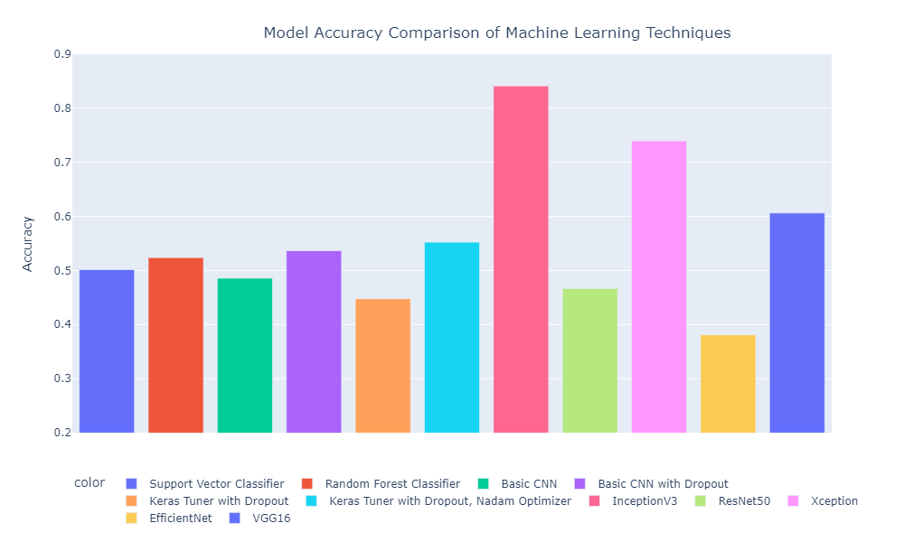
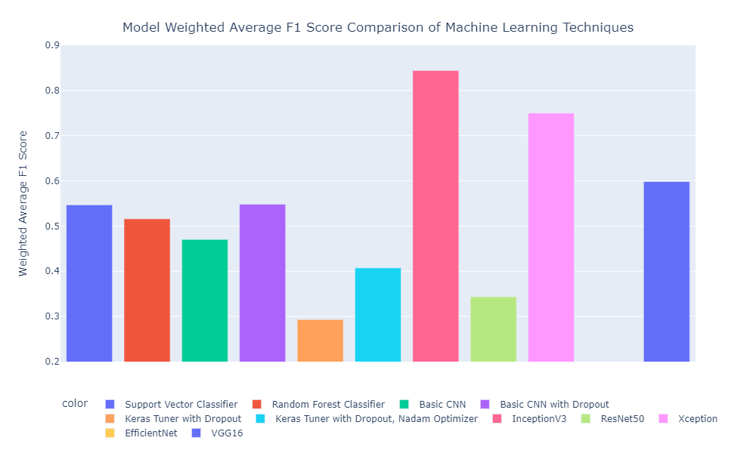
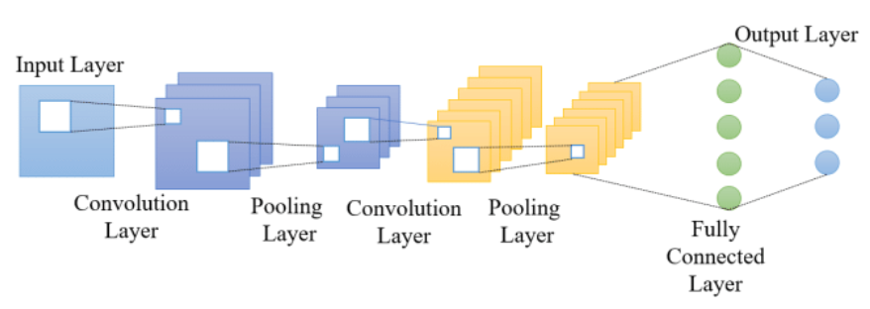
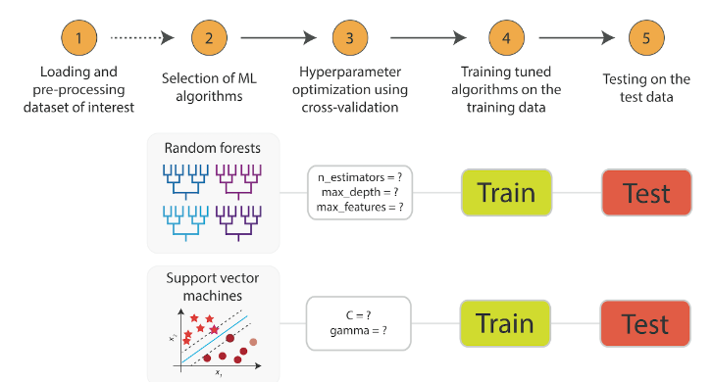
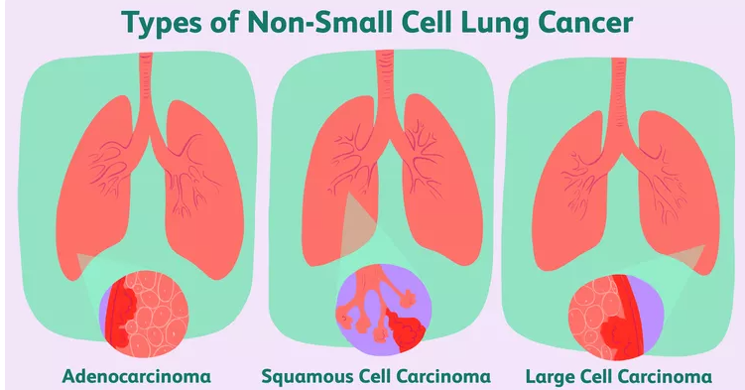
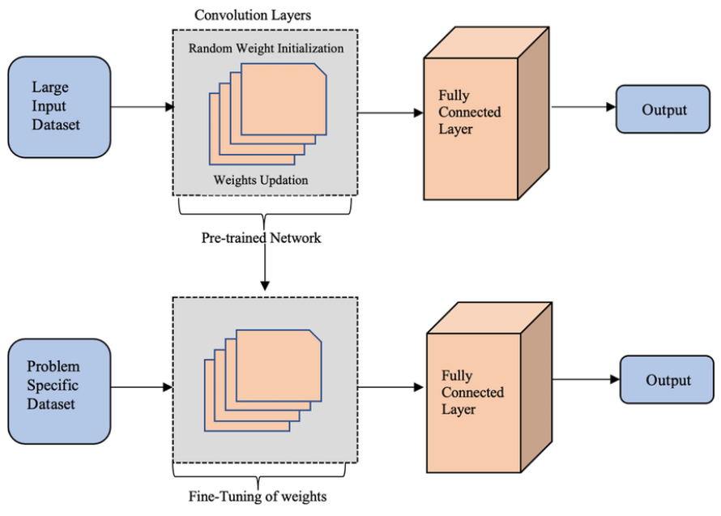
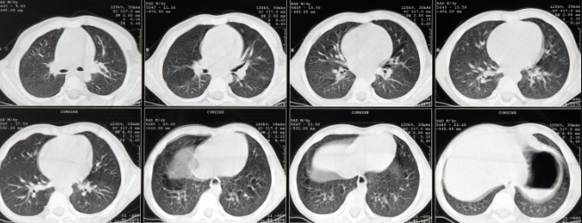
Detection of Lung Cancer Using Convolutional Neural Networks
Dosbol Aliev, Kurmanbek Bazarov, Michael Moorman, Abraar Patel
_{Mentor: Dr. Nouhad Rizk}
Department of Computer Science, University of Houston
Methods
Results
Abstract
Results
Cancer detection in the early stages is a significantly useful tool for decreasing cancer mortality and improving outcomes for patients. This research focuses on comparing implementations of machine learning algorithms to classify different types of lung cancer. The models utilize pre-processed and regularized axial chest CT scans of patients with either one of three non-small-cell lung carcinomas, or no cancer. Traditional supervised learning models Support Vector Classifiers (SVC) and Random Forest Classifiers (RFC) are compared to deep learning models using Convolutional Neural Networks (CNN) by comparing their respective model accuracies and weighted F1 scores, with special care given to false positive and false negatives in cancer detection. The study uses techniques involving hyperparameter tuning, Dropouts, and regularization techniques to control overfitting in the CNN model and get an efficient model that makes accurate predictions of lung cancer detection. The research also involved using transfer learning models such as InceptionV3, Xception, EfficientNetB2, ResNet50 and VGG-16. All transfer learning models used a different number of layers and trainable parameters, with the majority of the transfer learning models obtaining satisfactory model accuracies on the testing data with minimal loss.
Basic CNN: 2 Convolution Blocks plus MaxPooling, 2 fully-connected layers with ReLU activation.
CNN with Dropout: 50% Dropout rate used to increase basic CNN model accuracy by 5-7 percent. By doing this, Dropout layer decreases co-adaptability. In this manner, the neurons can generalize effectively when CNN model chooses a sample from the training set.
CNN with Keras Tuner: Basic CNN model trained with hyperparameter tuning using Keras tuner with Nadam optimizer to further increase model accuracy.
Non-neural network models like Support Vector Classifier (SVC) and Random Forest Classifier (RFC) trained with hyperparameter tuning using RandomizedSearch cross validation.
Transfer learning models used:
1) InceptionV3 : Input image is 224×224 RGB image. 23,626,728 trainable parameters and the model is 48 layers deep.
2) Xception: Input image is 299×299 RBG, 22,855,952 trainable parameters and the model is 71 layers deep.
3) EfficientNetB2: Input image is 224x224 RGB, 11M trainable parameters with 342 layers.
4) ResNet50: Input image is 224x224 RGB image. 602,116 trainable parameters and the model is 50 layers deep.
5) VGG-16: Similar to Basic CNN but larger/longer. 224 × 224 RGB image with 5 convolution blocks
Conclusion
Background
Basic CNN models had poor accuracy and were prone to skewed results.
Adding dropout and hyperparameter tuning did not improve the basic models significantly
Non-CNN methods had low accuracy and took more time to train
Pre-trained transfer learning models of larger size and complexity had much higher accuracy, with only a relatively small amount of training on this dataset
Chest CT scans use special X-ray equipment to examine abnormalities and help diagnose the cause of chest symptoms in an accurate way. Since chest CT scans have ability to detect small nodules in lung, they are very effective in diagnosing lung cancer at the most curable stage.
There are mainly two types of lung cancer, which are non-small cell cancer and small cell cancer. Non-small cell carcinomas are the most common type of lung cancer.
Non-small cell lung cancer includes adenocarcinoma, squamous cell carcinoma, and large cell carcinoma. Each non-small cell cancer has different symptoms and treatment methods and hence it is very important to distinguish the subsets of non-small cell lung cancer. Early detection of lung cancer is of utmost importance and helps reduce the mortality rate.
Future Direction
Create larger, more sophisticated models using an expanded dataset, to see if the accuracy of transfer learning models can be improved. This would require a larger dataset and more computing power.
Create object detection model to situate the tumor in the image, using techniques like R-CNN to perform classifications on subsets of the image. This requires ground-truth data on the general location of tumors in the lung cavity for patients who had cancer.
_{Basic CNN architecture}
Hyperparameter tuning on SVC and RFC models
Transfer Learning models architecture
Acknowledgments
We would like to thank our mentor, Dr.Nouhad Rizk, for her
guidance throughout the project. Her feedback helped us carry
out this research project successfully. We also thank Mohamed Hany for compiling the chest CT scan images dataset from public domain sources
Chest CT Scan Images of Lung Cancers
_{Adenocarcinoma,}
_{squamous cell carcinoma,}
_{large cell carcinoma}

